Slide 1
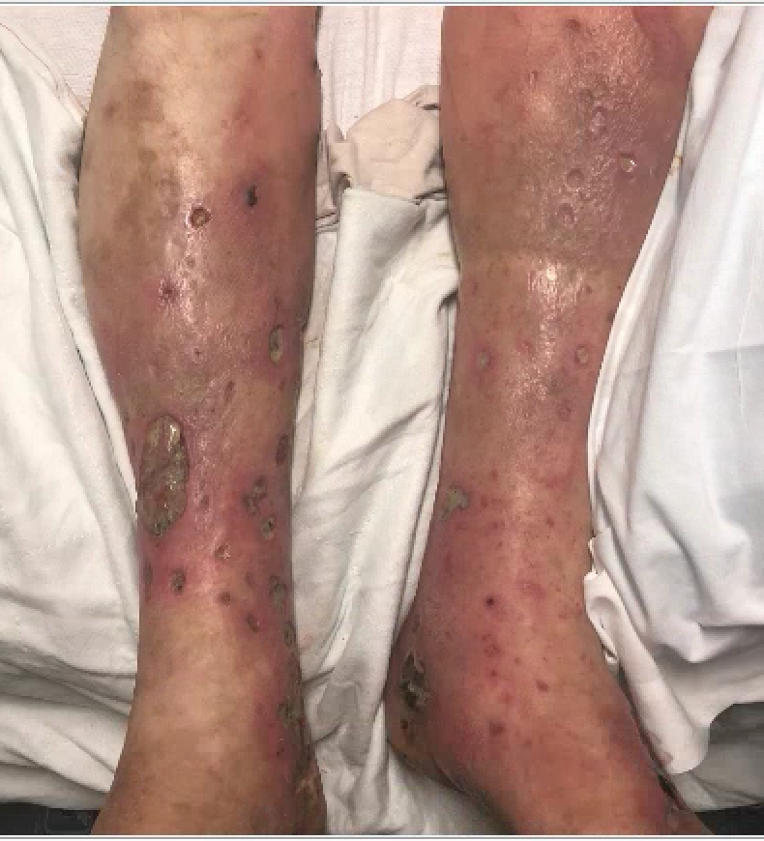
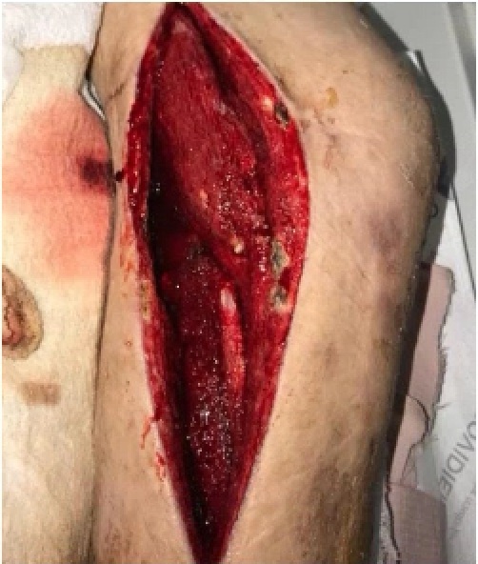
Keep the buprenorphine in place! Treating severe pain in a hospitalized patient with opioid dependence
Timothy J. Wiegand MD
Department of Emergency Medicine, University of Rochester Medical Center, Rochester, NY USA
Background:
Buprenorphine (bup) is a partial mu opioid receptor agonist used to treat opioid dependence. It is available in various formulations including bup alone and co-formulated with naloxone (4:1 ratio).
A growing number of patients are prescribed bup as the US, and other countries, are in the midst of an opioid crisis with increasing overdose rates and other complications associated with addiction and opioid use disorder.
Despite bup being available both for pain and dependence (in the US) clinicians are often unprepared to appropriately dose it or add the right agents to maximize analgesia when this is needed.
When severe pain occurs, or perioperatively, it is often suggested that bup be discontinued and full opioid receptor agonists substituted.
This can be challenging and dangerous with risk of relapse and under treatment of dependence, withdrawal and pain.
There are effective strategies to maximize analgesia with buprenorphine.
I describe an approach to treating severe pain while leaving bup in place in an opioid dependent patient.
Case Report:
A 44-year-old male with IVDU with daily heroin and cocaine use was hospitalized for lower extremity cellulitis, abscess and septic arthritis.
Shortly after admission he was started on buprenorphine (2/0.5 mg SL x 1) for withdrawal which was titrated to 8/ 2 mg SL three times daily.
The patient underwent a complicated incision and drainage procedure for a large abscess and septic joint with full opioid receptor agonists added to bup along with adjunctive medications; acetaminophen, a TCA and toradol (NSAID).
After the debridement he was left with a large, complex, wound requiring daily dressing changes and cleaning causing, “severe pain.”
Buprenorphine Pain Tx Algorhythm
1. Divide bup* (e.g. maint. on 16 mg/day → 4 mg SL QID).
2. Increase AND split dose (e.g. if 16 mg/day increase to 8 mg SL TID)
3. Add supplemental dose of bup (e.g. if 16 mg/day add 4 mg SL BID PRN to 8 mg SL BID or TID)
4. Add IV bup for acute pain/procedure 150-300 micrograms IV over 30 min pre/post procedure or q 6 hours PRN.
5. Add full agonist on top of bup at 2-3 x standard dose & continue bup (e.g. 20-30 mg oxycodone PO q 4 hours (moderate/severe pain) + bup.
6. Add full agonists IV on top of background bup at 2-3 x standard dosing & continue bup (e.g. hydromorphone 4-6 mg IV).
Ketamine analgesia
Consider regional anesthesia or spinal/epidural if appropriate
Maximize non-opioid agents (NSAID, apap, lidocaine, TCA)
* Bup can be dosed as mono or dual product where bup dosing above could replace with bup/naloxone 4/1 ratio the naloxone does not effect analgesia.
Case Report Continued…
The patient was titrated from 2 to 4 mg and ultimately 6 mg hydromorphone dose was administered IV immediately prior to wound care with good analgesic effect without sedation or respiratory depression.
Adjunctive agents were continued along with a sedative (oral lorazepam 0.5 mg) given one hour prior to the hydromorphone as an anxiolytic and opioid potentiator.
Conclusion:
Common dogma regarding buprenorphine is that it is not effective for severe pain as the buprenorphine has a ‘ceiling effect and “blocks” other opioids.
The ‘blockade’, however, can be overcome by increasing full agonist doses 2-3 fold and there is less ‘blockade’ of analgesia compared to other opioid effects (euphoria, sedation, respiratory depression).
Maximize bup analgesia by split dosing (q 6-8 hours instead of daily or BID). And treatment for withdrawal/dependence is preserved with bup continued.
In our patient buprenorphine was split (8/2 mg three times daily) with full agonist + adjunctives with excellent effect.
Buprenorphine was continued throughout the hospital stay and the patient ultimately bridged with it to an outpatient program at discharge without interuption.

