Slide 1
Medication Assisted Treatment Program in NYSDOCCS 2021

Slide 2
Objectives
1. Overview of DOCCS
2. Overview of Health Services
3. Beginning of MAT in NYSDOCCS
4. Expansion of MAT
5. Future of MAT in NYSDOCCS
Notes:
Average nursing vacancy rate is 22.51%
Significant shortages (25% or greater) at 22 facilities
RN2:
Budget fill level 741.5 (actual 565.2)
Current vacancy-176.3 as of 3/15/19
Shortage across healthcare titles (except for NP and PA’s)

Slide 4
DOCCS Health Services
$400M Budget
52 Facilities statewide (Decreasing due to reduction in incarcerated population)
30 Infirmaries; 24 Pharmacies; 20 Radiology suites
Five Regional Medical Units
Bedford (Women’s Facility)
Coxsackie
Wende (Dialysis Unit)
Walsh
Fishkill (Unit for Cognitively Impaired & Dialysis Unit)
Notes:
Describe each RMU- what they consist of i.e. LTC etc

Slide 5
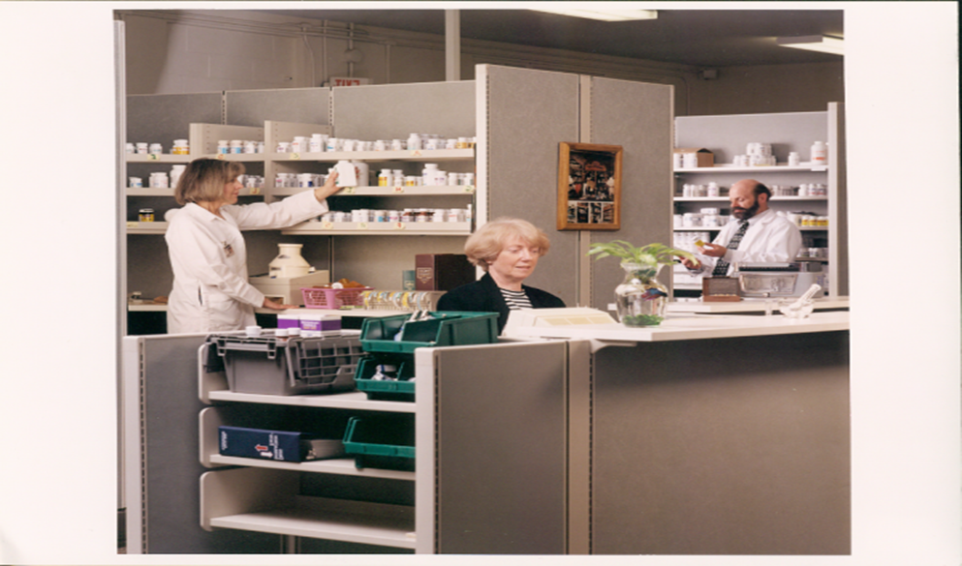
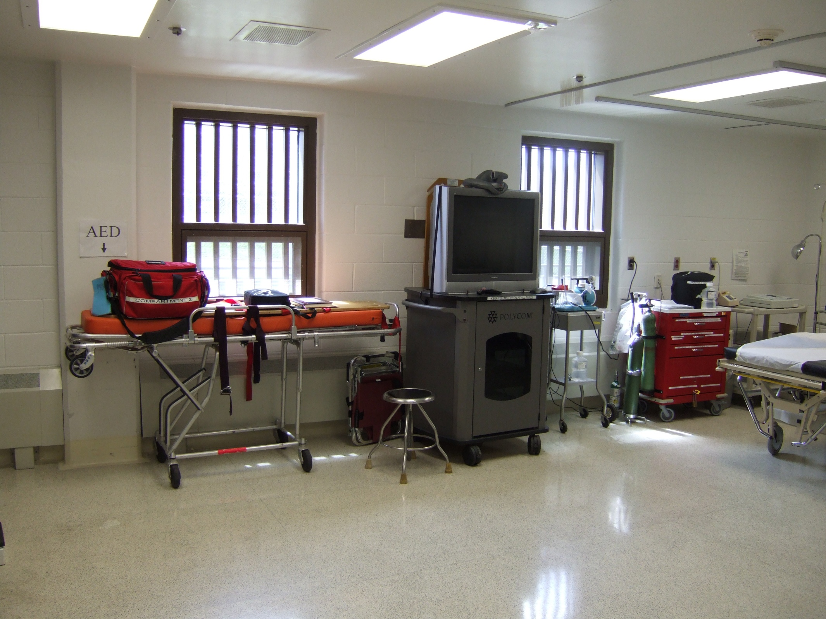
Telemedicine
Regional Medical Unit
Pharmacy

Slide 6
Medical Team
1,200 Health Services staff
Physicians
Nurse Practitioners
Physician Assistants
Registered Nurses
Radiology Technicians
Pharmacists
Dentists, Dental Hygienist, Dental Assistants
All Providing Primary Care to 35,000 incarcerated
Notes:
Nutritionist

Slide 7
Specialty Care Clinics
Over 1,000 contracts for every type of Specialty Care
Surgery – General, Ortho, ENT, Podiatry, Neuro, Ophtho, Thoracic, Vascular…
Medical – Cardio, Pulm, Endo, Rheum, Pain, GI Neurology, Renal….
MRI, Cat scan, ultrasound
Optometry, Endoscopy, PT/OT, Audiology

Slide 8
M.A.T. in DOCCS

Slide 9
MAT and Pregnant Inmates
Since 2010 NYS DOCCS has provided Methadone to pregnant female population.
Stabilize the patient & fetus during this time.
The patient is weaned off within 2 months of delivery

Slide 10
Expanding the MAT Program
In response to the Opioid epidemic Gov. Cuomo announced in 2018 that M.A.T. would be expanded to the general population.

Slide 11
Return Parole Violators
The MAT program was extended to return parole violators from Rikers who had less than 3 months
remaining on their sentence and who had
sentence and who had been enrolled in an
Opioid Treatment program in their
community. Qualifying inmates would
transfer into Queensboro C.F., who partnered with Samaritan Daytop Village OTP. DOCCS would provide Guest Dosing of Methadone.

Slide 12
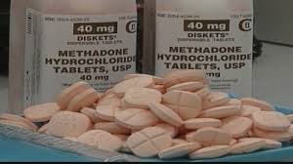
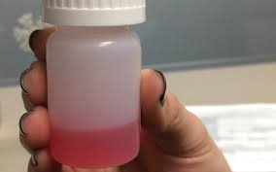
Second Expansion
The program was successful and was expanded by the Commissioner to Downstate and Elmira C.F. – 2 reception sites.
Downstate CF partnered with Lexington OTP in Poughkeepsie and Elmira partnered with United Health Services in Binghamton to acquire Methadone.

Slide 13
Growing Program
The inmates transferred from Rikers to Downstate on Thursdays until the following Tuesday when they transferred to Elmira CF.
Maximum security incarcerated remain at Elmira Correctional until they were paroled. Elmira CF expanded about 150 patients.

Slide 14
Medium Facilities
Medium Security inmates who meeting
criteria were then transferred to Wallkill,
Marcy and Cayuga Correctional Facilities.
Wallkill - Lexington OTP - wafer Methadone
Cayuga - Crouse OTP - liquid Methadone
Marcy - Beacon OTP - liquid Methadone

Slide 15
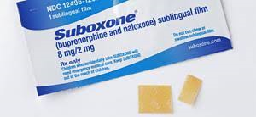
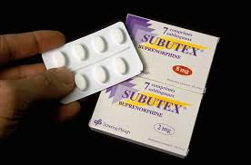
Buprenorphine
In mid 2019, the Commissioner made the decision to expand our program to include Buprenorphine in the form of Suboxone and Subutex.
Currently available in 5 CFs where we have providers with X-Waivers. We anticipate expanding Buprenorphine access in 2021.

Slide 16
State of the State
In the 2020 State of the State address, the Governor announced that NYSDOCCS would pursue becoming its own Opioid Treatment Program. COVID-19 has slowed that progress, but to date, we have submitted our application to NCCHC for the accreditation. We have also identified a site for the OTP and started the hiring process for the personnel needed.

Slide 17
Looking Ahead
This process has been a learning experience for everyone involved and we look forward to the continued expansion of the program.

Slide 18
NYSDOCCS MAT PROGRAM
A Continual Improvement Process

Slide 19
QUESTIONS

