Slide 1
40 years of Methadone Regulation: Impacts on access to opioid agonist treatment (OAT) in Ontario, Canada
Mel Kahan MD
Lori Regenstreif MD
Andrew McLeod
New York Academy of Addiction Medicine
May 31, 2023

Slide 2
Introductions
Mel Kahan
Lori Regenstreif
Andrew McLeod

Slide 3
Learning Objectives
Describe methadone regulation in Ontario between 1980-2015
Describe impact of fentanyl in the street supply, and of COVID-19, on policy and practice change in 2018-2022
Understand one individual’s experience with methadone treatment in Ontario
META:PHI = MENTORING, EDUCATION and clinical TOOLS for ADDICTION: PARTNERS IN HEALTH INTEGRATION (Women’s College Hospital, Ontario Ministry of Health)

Slide 4
Financial Disclosures
Mel Kahan
Medical Director of META:PHI, which oversees Ontario’s RAAM clinics; funded by the Ministry of Health
Lori Regenstreif
Indivior - honoraria, advisory board, unrestricted education grants
Master Clinician Alliance – Canadian College of Family Physicians CME on OUD
METAPHI Advisory Committee, stipend
Andrew McLeod
Community consultant, METAPHI, honoraria

Slide 5
Mel

Slide 6
1980-2015
Evolution of methadone guidelines
Regulatory management of methadone prescribing
Benefits and consequences

Slide 7
Ontario 1980 -1990
Methadone could only be prescribed by physicians who were granted an exemption by the Federal Bureau of Controlled Substances
Only one methadone program in whole province – Centre for Addiction and Mental Health in Toronto (CAMH)
Patient roster capped at 100 even when number of heroin users rose due to drop in price and increase in potency

Slide 8
Ontario 1990 – 2015
Family physicians could get an exemption by requesting one in writing
Soon several family physicians had large methadone practices
Family physician involvement greatly expanded access to methadone treatment
Some iatrogenic overdose deaths due to aggressive dosing during initial titration
The College of Physicians of Surgeons of Ontario (CPSO) arranged with the Bureau of Controlled Substances to grant exemptions
In order to receive an exemption, the physician was required to:
Attend a four hour course and pass an exam
Attend four half-day clinics with a methadone prescriber

Slide 9
Ontario 1990 – 2015
CPSO published three guidelines and standards – 1998, 2006 and 2011
The standards contained detailed instructions on:
Dose titration and maintenance dose
Frequency of urine drug testing
Schedule for take-home dosing based on urine drug tests

Slide 10
Ontario 1980 – 2015
CPSO conducted yearly audits on all prescribers
Physicians who were non-compliant were re-audited in six months
In some cases the exemption to prescribe methadone was revoked
Examples of non-compliance:
Giving take-home doses before two months of daily dosing
Not collecting/following weekly urine drug screens
Prescribing benzodiazepines in addition to methadone

Slide 11
Benefits of the regulatory program
Close to 100% compliance with titration schedule
Iatrogenic overdose became rare
Take-home dose regulations may have reduced overdose deaths due to diverted methadone
Consistency in prescribing across practices

Slide 12
Unintended consequences
The provincial drug plan (OHIP) paid physicians for each office visit and each urine drug screen
Physician entrepreneurs stepped in and built chains of methadone clinics designed to generate OHIP revenue using a tight business model
Patients were required to see the physician and leave a urine sample one to two times per week, regardless of the clinical need, on an ongoing basis

Slide 13
Unintended consequences
High volume” physicians would see 90 patients in a day on average, rendering the visits too short to be clinically useful
Patients who missed their appointments could be discharged from the program with no alternative in their community
Result: Low treatment retention rates
Patients sometimes had to choose between work and OAT
Hostility between patient and care provider
Easier and more pleasant to just use opioids

Slide 14
Evidence for methadone prescribing in primary care settings
One RCT found that outcomes for stable patients transferred to primary care were just as good as those who continued with their licensed narcotic treatment program (Fiellin 2001)
An RCT from France found that methadone induction with illicit opioid users was as effective in a primary care setting as in a specialized setting. Primary care patients had comparable treatment retention rates, and greater engagement and satisfaction (Carrieri 2014)
A systematic review of systematic reviews and RCTs concluded that methadone and buprenorphine treatment had higher treatment retention rates in primary care settings than specialized settings (Korownyk 2019)

Slide 15
Methadone patients and primary care
Methadone patients have higher rates of chronic illness than matched controls (O’Toole 2014)
Yet one provincial case-control study found that OAT patients in specialized clinics were far less likely to receive standard cancer screening or diabetic monitoring than matched controls (Spithoff 2019)
Conclusion: There is an urgent need to integrate OAT into primary care
Better quality of care, greater access to treatment, possibly higher rates of retention and patient satisfaction

Slide 16
Lori

Slide 17
2015 – present
Fentanyl appears in heroin
Overdoses rise
COVID-19 drives new approaches

Slide 18
2015 Street fentanyl appears in Canada
Fentanyl quickly spread from BC to Ontario
“Popcorn” – heroin/fentanyl
Increased potency of street supply
Increase in opioid overdoses
Increasing opioid tolerance
Reduction in anti-craving benefits of methadone

Slide 19
Fentanyl and the practice landscape
The CPSO standards prevented a nimble response by physicians to adapt their practices
Rules were rigid and inflexible:
Dose could only be increased in-person visit
3 missed days, the dose had to be reduced to 30 mg
Missing appointments meant Rx often not renewed
The result: declining treatment retention rates for people who use fentanyl
2017 buprenorphine becomes “first-line” OAT in Canada but fentanyl presented new challenges
Street demand up; street supply up; costs came down – fentanyl became “cheap and easy” relative to OAT

Slide 20
Policy change
Regulatory oversight had stigmatized methadone despite evidence of benefit for people who use fentanyl
CPSO abandoned the regulatory program in 2020 and removed the methadone guidelines from their website
Most methadone clinics continued to follow previous, rigid rules
A few MDs took on buprenorphine Rx

Slide 21
2014-2020 – new models of care
Expansion of ‘Rapid Access Addiction Medicine’ (RAAM) clinics and across Ontario
Low barrier, accessible; referral from EDs; ED and hospital starts at a few sites
Most RAAM clinics prescribe OAT – mainly buprenorphine and manage alcohol and other substances, usually refer methadone Rx to community clinics
Few EDs or hospital were/are willing to prescribe methadone – slowly changing
RAAM clinics and some hospital funding has built capacity for OAT care in some regions

Slide 22
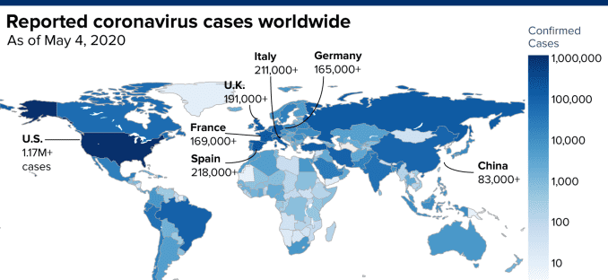
2020-2022 COVID-19
COVID made it potentially unsafe for patients to attend the pharmacy daily or the clinic twice per week; a quick pivot was needed
Various organizations (META:PHI, OMA, CAMH) quickly came together to produce provisional guidelines on take-home doses
Analysis of provincial data: Patients who had daily observed dosing pre-COVID and were given carries post-COVID had increased treatment retention rates compared to those who continued with daily dosing post-COVID

Slide 23
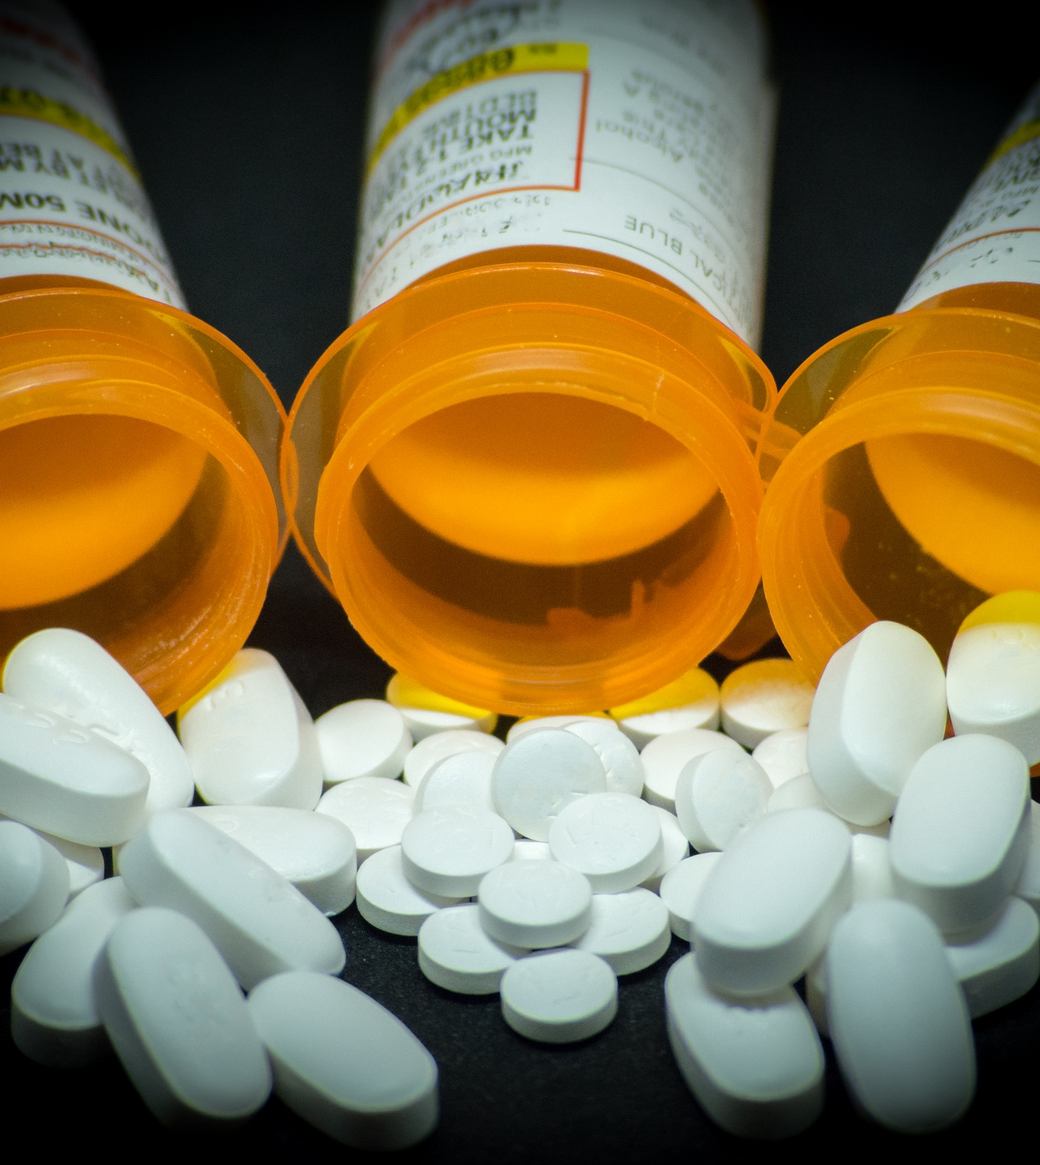
Policy change: “Safer Supply”
Tight restrictions on methadone prescribing and dispensing led to a harm reduction “emergency response” – some of it beneficial – OPS, outreach, SCS
MDs – and now NPs – unregulated re: opioid prescribing
‘Safe Supply’ funded by Health Canada (federal)
Stated intent to “replace the toxic street supply”
Take-home HM tablets (>30-40/day, variable dispensing intervals – daily, monthly…)
Controversial and politicized

Slide 24
June 2022
Changes to dosing strategies to lower barriers to starting and restarting methadone within the safety margins of methadone pharmacology
Addition of slow-release oral morphine (SROM, “Kadian”) to augment the relief of cravings and improve engagement in the first weeks of treatment
Increased flexibility in scheduling doctor visits, dose increases and use of SROM
Emphasis on engagement in treatment, communication with pharmacists and reduction in barriers to access

Slide 25
OAT treatment today
Methadone - usually most requested in unstable fentanyl use; contingency-based, take-home dosing when stable; based on negative urine testing weekly; patient and public safety remain key concerns
Buprenorphine, may have 28 days of take home doses when stable, often with no observed doses – more flexible but not incentivized for prescribers or pharmacies
Slow-release oral morphine (SROM, Kadian®) – in conjunction with methadone; alone as OAT; early evidence
Injectable buprenorphine (Sublocade®): Monthly injection
Naloxone kits – wide distribution, free, most pharmacies

Slide 26
OAT treatment today
Most clinics in Ontario are methadone focused and provide little else
Ideal (“dream team”) model provides access to primary care, HIV, HCV, mental health support and case management, plus pharmacist participation
Most pharmacies dispense methadone, especially in larger urban areas
Access in rural and remote communities challenging and buprenorphine lends itself to easier models
Pharmacists usually communicate with prescribers – many clinics have a pharmacy inside – pros and cons

Slide 27
2022 onward
Any physician or NP can prescribe methadone, SROM or buprenorphine
Strong evidence that initiating OAT in hospitals and EDs is effective at engaging patients in community OAT treatment
Few, but increasing, EDs or hospitals initiate OAT on site
META:PHI has developed clinical materials and educational events to encourage providers to initiate methadone, sublingual and depot buprenorphine in EDs and hospitals

Slide 28
May 2023 -Patient-centred -Based on COVID lockdown study evidence -Informed by PWLE and pharmacists

Slide 29
Andrew McLeod
A personal account of being on OAT and in recovery from OUD

Slide 30
Our conclusions…
Deregulation improves access to OAT and treatment retention rates:
All clinicians and all health care settings can prescribe methadone
Practices regarding take-home dosing, script renewals based on clinical judgment and patient-focused
Deregulation allows for innovation, which is the only way to mount an effective response to the fentanyl crisis
Deregulation should be accompanied by intensive efforts to educate prescribers on methadone treatment, provide them with clinical tools, and build hospital based addiction consult services
Strong leadership in the addiction field with broad stakeholder consultation is essential

Slide 31
Post-test question #1
Benefits of a closely regulated methadone program are:
High compliance with titration schedule
Lower risk of iatrogenic overdose
Take-home dose regulations may reduce deaths due to diverted methadone in opioid naïve persons
All of the above

Slide 32
Post-test question #1
Benefits of a closely regulated methadone program are:
High compliance with titration schedule
Lower risk of iatrogenic overdose
Take-home dose regulations may reduce deaths due to diverted methadone in opioid naïve persons
All of the above

Slide 33
Post-test question #2
Integration of OAT with primary care is likely to:
Improve quality of care
Decrease access to substance treatment
Reduce rates of retention on methadone
All of the above
None of the above

Slide 34
Post-test question #2
Integration of OAT with primary care is likely to:
Improve quality of care
Decrease access to substance treatment
Reduce rates of retention on methadone
All of the above
None of the above

Slide 35
Post-test question #3
The appearance of fentanyl in the street supply:
Increased opioid tolerance in many people with OUD
Increased demand for stronger opioids
Increased overdose death rates
Increased retention in treatment due to higher demand for methadone
--------WHICH OF THE ABOVE IS INCORRECT?

Slide 36
Post-test question #3
The appearance of fentanyl in the street supply:
Increased opioid tolerance in many people with OUD
Increased demand for stronger opioids
Increased overdose death rates
Increased retention in treatment due to higher demand for methadone
--------WHICH OF THE ABOVE IS INCORRECT?

Slide 37
Post-test question #4
COVID-19 pandemic lockdowns led to:
Increased retention in treatment
Decreased access to street fentanyl
Decreased access to methadone treatment
Increased cost of street fentanyl

Slide 38
Post-test question #4
COVID-19 pandemic lockdowns led to:
Increased retention in treatment
Decreased access to street fentanyl
Decreased access to methadone treatment
Increased cost of street fentanyl

Slide 39
References
Carrieri PM, Michel L, Lions C, Cohen J, Vray M, Mora M, Marcellin F, Spire B, Morel A, Roux P; Methaville Study Group. Methadone induction in primary carefor opioid dependence: a pragmatic randomized trial (ANRS Methaville). PLoS One. 2014 Nov 13;9(11):e112328. doi: 10.1371/journal.pone.0112328. PMID: 25393311;PMCID: PMC4231094.
Fiellin DA, O'Connor PG, Chawarski M, Pakes JP, Pantalon MV, Schottenfeld RS. Methadone maintenance in primary care: a randomized controlled trial. JAMA. 2001 Oct 10;286(14):1724-31. doi: 10.1001/jama.286.14.1724. PMID: 11594897.
Korownyk C, Perry D, Ton J, Kolber MR, Garrison S, Thomas B, Allan GM, Dugré N, Finley CR, Ting R, Yang PR, Vandermeer B, Lindblad AJ. Opioid use disorder in primary care: PEER umbrella systematic review of systematic reviews. Can Fam Physician. 2019 May;65(5):e194-e206. PMID: 31088885; PMCID: PMC6516704.
O'Toole J, Hambly R, Cox AM, O'Shea B, Darker C. Methadone-maintained patients in primary care have higher rates of chronic disease and multimorbidity, and use health services more intensively than matched controls. Eur J Gen Pract. 2014 Dec;20(4):275-80. doi: 10.3109/13814788.2014.905912. Epub 2014 May 5. PMID: 24798090.
Spithoff S, Kiran T, Khuu W, Kahan M, Guan Q, Tadrous M, Leece P, Martins D, Gomes T. Quality of primary care among individuals receiving treatment for opioid use disorder. Can Fam Physician. 2019 May;65(5):343-351. PMID: 31088874; PMCID: PMC6516690.

Slide 40
Resource links
www.metaphi.ca
http://crismontario.ca/research-projects/opioid-treatment-guidelines
http://www.cmaj.ca/content/190/9/E247
www.canada.ca/en/health-canada/services/health-concerns/controlled-substances-precursor-chemicals/exemptions/methadone-program.html

Slide 41
Thank you! Questions?
CONTACT:
regensl@mcmaster.ca

