Slide 1
Opioid Analgesic Risk Evaluation and Mitigation Strategy (REMS)
Meeting the Challenge of Pain Management
in an Ever-evolving Opioid Epidemic

Slide 2
Program Implementation Team Contacts*
Timothy Wiegand*, MD, FACMT, FAACT, DFASAM
New York Society of Addiction Medicine, Immediate Past President
Director, Addiction Toxicology & Toxicology Consult Service
Associate Professor of Emergency Medicine
Strong Memorial Hospital and University of Rochester Medical Center
Rochester, New York
Kelly Ramsey, MD, Jade Malcho, MD, Ross Sullivan, MD –NYSAM members.
Frank North, PharmD
National Pharmaceutical Association, President-elect
Steven Haimowitz, MD, RealCME
Carol Pashman, MS, RN, MedicusCME

Slide 3
What is Opioid Analgesic Risk Evaluation Mitigation Strategy (REMS)?
2012 FDA approved the Extended Release and Long-Acting (ER/LA) Opioid Analgesic Risk Evaluation Mitigation Strategy (Opioid REMS)
As part of Opioid Analgesic REMS, all opioid analgesic companies must provide education for prescribers and others who participate in the treatment and monitoring of patients who receive opioids, including pharmacists and nurses
Education offered through accredited continuing education (CE) activities
2018 CE grants program established under Opioid REMS

Slide 4
Overall Goals of Curriculum
Develop a REMS*compliant curriculum covering FDA blueprint
Generate 2000 participants completing the curriculum via a digital small-group learning platform (100 groups)
Representation from the following groups: physicians, residents, PAs, APNs, pharmacists, nurses

Slide 5
The Gather-ed digital platform offers a social learning experience that prioritizes engagement, peer-to-peer learning, and mentorship within a small group setting. It is designed for busy healthcare professionals interested in a collaborative educational experience that delivers formative learning along with group and one-to-one interactions and discussions.
Gather-ed Components
Digital Self Study Modules:
Baseline and Final self-assessments
Topic-specific modules
Platform-native messaging enables communication throughout
“Group Happenings” forum
One-to-one messages
Group task feedback comments
Asynchronous
Live group discussions via video conferencing
Synchronous
Collaborative group tasks, with individual contributions reviewed by other group members
Asynchronous
Collaborative / Asynchronous

Slide 6
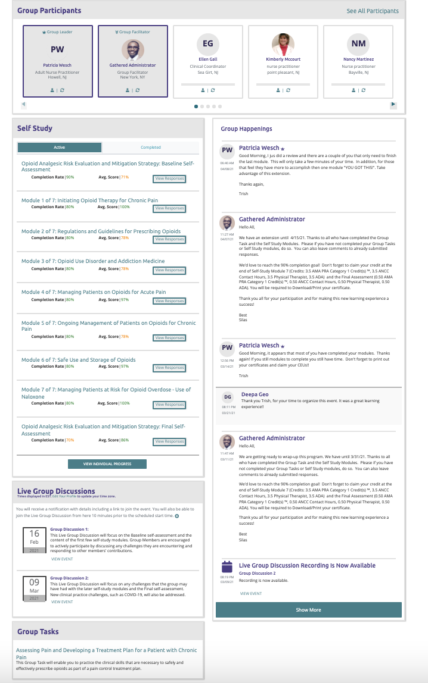
Gather-ed Platform: Learning Components
Group Member Roster
Self Study Modules
Group Happenings / Forum
Live Group Discussions
Group Task

Slide 7
Roles Within a Gather-ed Group
Group Leader (Mentor)
Group Facilitator (Teaching Assistant)
Group Member (Participating Learner)

Slide 8
Responsibilities of Group Leaders
Each group leader will recruit up to 20 group members from their network of personal/professional colleagues
Group Leaders (GLs) do not need to be experts in opioid prescribing; do not teach curriculum
GLs will be trained in use of the e-platform (45-minute training session)
During 4+ weeks, will facilitate/ encourage group members (learners) and host one Zoom meeting
Overall time commitment of GLs – approximately 4 hours over
4 - 5 weeks

Slide 9
Group Members will receive 4.5 AMA PRA Category 1 credit and APCE credits . . .
Group Leaders will receive an honorarium

Slide 10
Additional Benefits of Serving as a Group Leader
Research and leadership experience could enhance academic credentials on your curriculum vitae
Social, peer-to-peer learning helps establish strong professional networks
Opioid use and risk for addiction continues to evolve; curriculum is current
Pace and timing of group activities can be tailored to needs of each group (flexible)

Slide 14
Next Steps
To complete a Group Leader application, go to:
https://medicuscme.gathered.com/curriculum/108. You will
be invited to participate in Group Leader Gather-edTM training
via Zoom.
Questions, contact Carol Pashman, Project Coordinator, at carol@medicuscme.org

